Slide 1

Comparing Crime Rates & Hotel Ratings
Project Won
Kirby Miller
Alicia Perez
Meghan Luoma
Kerry Wehner
Sara Riggs

Slide 2
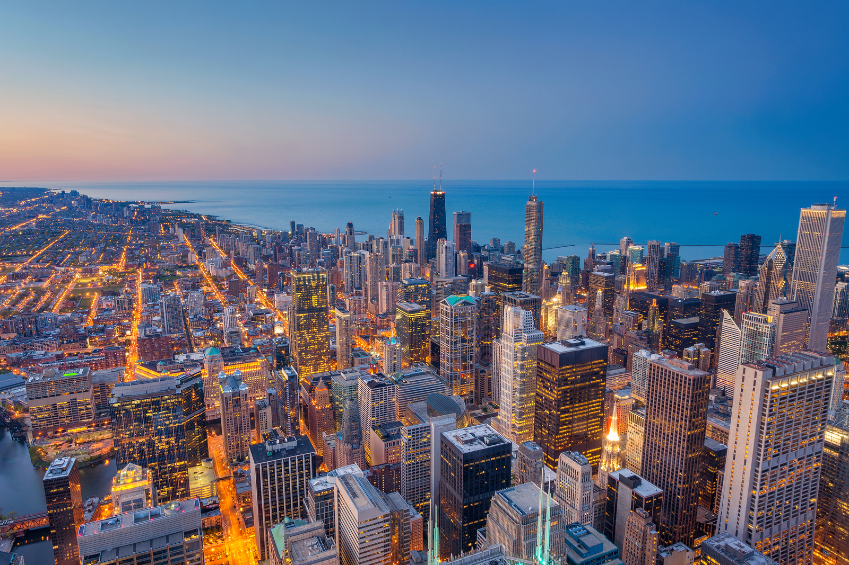

The Cities
Kansas City, MO
New Orleans, LA
Dallas, TX
Portland, OR
Charlottesville, VA
Chicago, IL
Denver, CO
Sioux Falls, SD
Las Vegas, NV
San Francisco, CA
Chattanooga, TN
Boston, MA

Slide 3

Kansas City, Missouri Population – 491,918

Slide 4
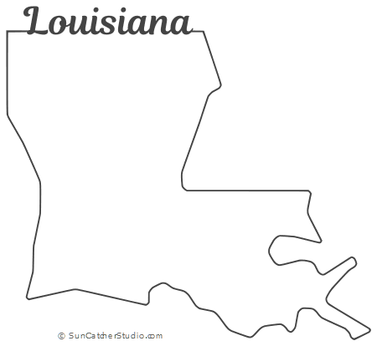
New Orleans, Louisiana Population – 391,000

Slide 5
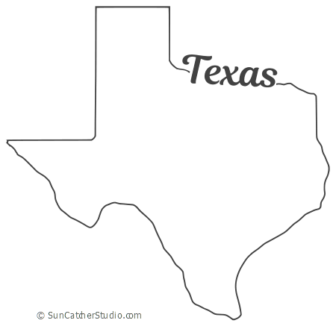
Dallas, Texas Population – 1.3 Million

Slide 6

Portland, Oregon Population - 653,000

Slide 7

Charlottesville, Virginia Population – 48,000

Slide 8

Chicago, Illinois Population – 2.7 Million

Slide 9

Denver, Colorado Population – 727,211

Slide 10
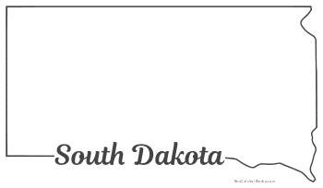
Sioux Falls, South Dakota Population – 181,883

Slide 11

Las Vegas, Nevada Population – 644,644

Slide 12

San Francisco, California Population – 3.3 Million

Slide 13

Chattanooga, Tennessee Population – 180,000

Slide 14

Boston, Massachusetts Population – 4.3 Million

Slide 15
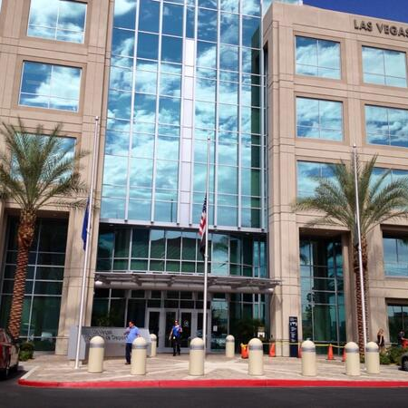

Police Stations
Kansas City Police Department
New Orleans Police Department
Dallas Police Department
Portland Police Bureau
Charlottesville Police Department
Chicago Police Department
Denver Police Department
Sioux Falls Police Department
Las Vegas Metropolitan Police Department
San Francisco Police Department
Chattanooga Police Department
Boston Police Department

Slide 16


Hotels

Slide 17
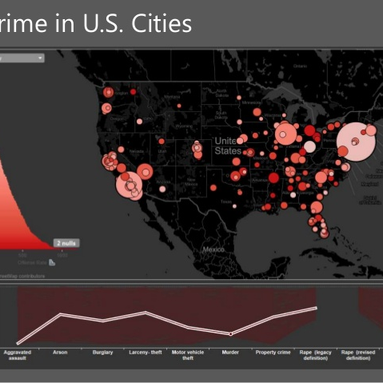
The Fact's

